Slide 1
Measuring Estimating Resilience
Chris Barrett
July 7, 2017
CGIAR Conference on
Impacts of International Agricultural Research
Nairobi, Kenya

Slide 2
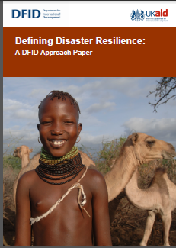
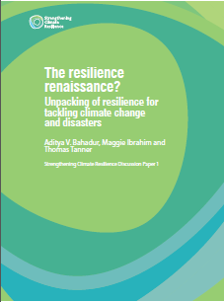
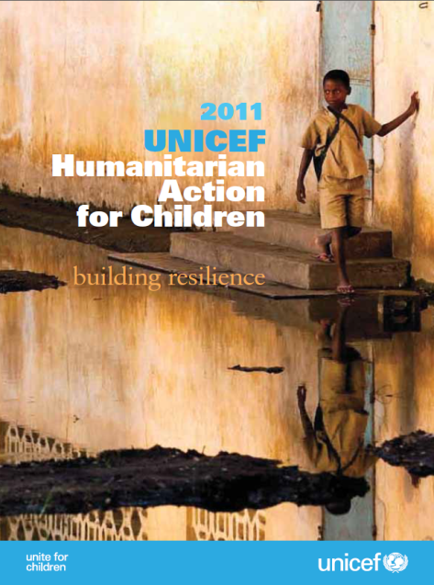
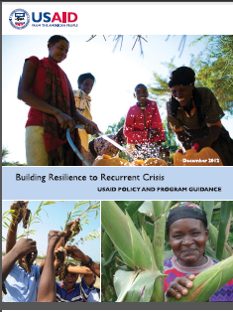
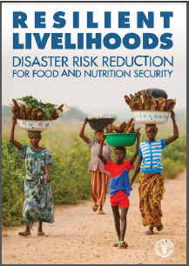
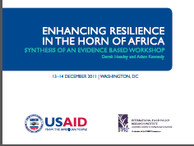
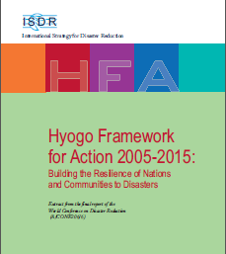
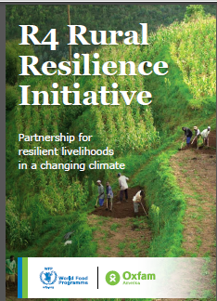

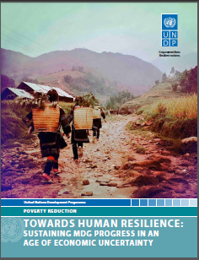
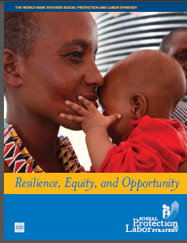
Motivation
“Resilience” has rapidly become a ubiquitous buzzword, but ill-defined concept within the development and humanitarian communities

Slide 3
Motivation
Why development and humanitarian communities’ current fascination with “resilience”?
Risk perceived increasing in both frequency and intensity
Recurring crises lay bare the longstanding difficulty of reconciling humanitarian response to disasters with longer-term development efforts.
Increasingly recognize interdependence of biophysical and socioeconomic systems. Tap ecological work on resilience.
Need theory-and-evidence-based understanding of what resilience is with respect to human well-being, how to measure/estimate it, and how to effectively promote it so as to sustainably reduce chronic poverty/food insecurity.

Slide 4
Challenge
Barrett & Constas (PNAS 2014) advances a theory of development resilience.
Core challenge: resilience is unobservable, a latent variable. We can only estimate, not measure, it. So data challenges.

Slide 5
Cissé-Barrett method
Cissé & Barrett (2016 WP) Approach To
Development Resilience Estimation
Application of Barrett-Constas (PNAS 2014) probabilistic, moments-based method to estimate well-being dynamics
Like poverty estimation, normative method. Assume:
(i) Level – Minimum acceptable standard of well-being (outcome) for individual or household.
  (ii) Probability – Minimum acceptable likelihood of meeting level criterion
  Development resilience is sufficient prob. of attaining an adequate standard of living (given shocks and stressors)

Slide 6
- In order to evaluate, must first be able to measure (if observable) or estimate (if unobservable).
- Estimate conditional moments of the well-being outcome variable, as a function of variables reflecting
(i) exogenous shocks (e.g., drought, illness, cyclone)
(ii) conditioners of exposure, recovery (e.g., gender)
(iii) interventions (plausibly exog., if evaluating)
(iv) polynomial lags of DV and shocks (i.e., nonlinear dynamics and cumulative, delayed response)
- Describe and predict time path of resilience for individuals of aggregates of individuals
Cissé-Barrett method
Estimating Resilience

Slide 7
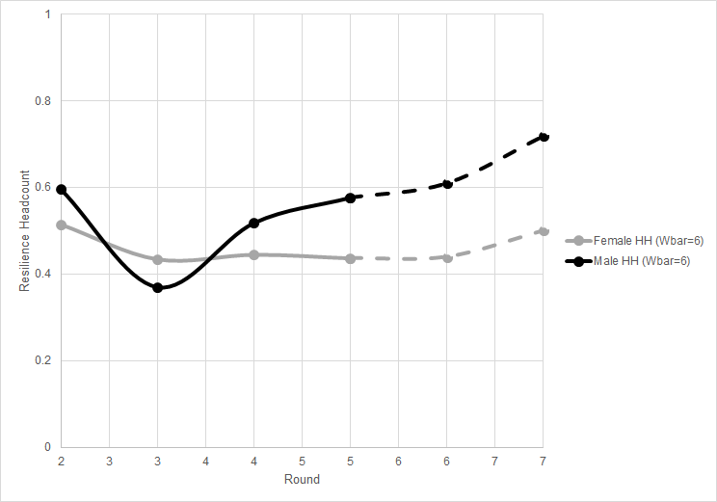
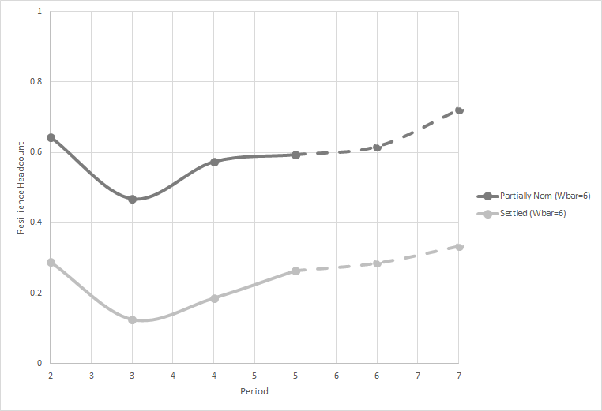
By gender of HH head By HH mobility
Cissé-Barrett method
Examples from northern Kenya pastoralists
Source: Cissé & Barrett 2016

Slide 8
Cissé-Barrett method
Examples from Zambia project by Heifer Int’l
Training and asset transfers significantly increase conditional mean and reduce conditional variance of household wealth over time. Total B/C ~ 7
[2.5,8,7] across hh wealth deciles
Source: Phadera, Michelson, Winter-Nelson & Goldsmith 2017

Slide 9
Extensions to Food Security
Can use same methods with food intake indicators as DVs. Satisfies axioms from 1996 World Food Summit definition of food security.

Slide 10
Extension: Food security & resilience in Tigray (Maxwell, Vaitla, Cissé, and Upton)
Extensions to Food Security

Slide 11

- Policymaker and program manager demand is great.
- Methods are becoming available to estimate dev’t resilience
- With careful research design, impact evaluation of efforts to build resilience are now possible.
Conclusion
Estimating Resilience
Thank you for your time and interest

